Slide 1
Digital Portfolio
STUDENT NAME: AKSHAYA PRIYA.M
REGISTER NO AND NMID: asunm1451212403585
DEPARTMENT: BCA
COLLEGE: MAHALASHMI WOMEN’S COLLEGE OF ARTS AND SCIENCE / UNIVERSITY OF MADRAS

Slide 3
Agenda
1. Problem Statement
2. Project Overview
3. End Users
4. Tools and Technologies
5. Portfolio Design and Layout
6. Features and Functionality
7. Results and Screenshots
8. Conclusion
9. GitHub Link

Slide 4
Problem Statement
Many students struggle to showcase their projects and skills effectively. A portfolio helps highlight achievements in a professional way.
Students often face challenges in presenting their skills, projects, and achievements in a clear and professional way. Traditional resumes are text-heavy and fail to demonstrate creativity, technical ability, and personality. Without a proper platform, students miss opportunities to impress recruiters, mentors, and peers.

Slide 5
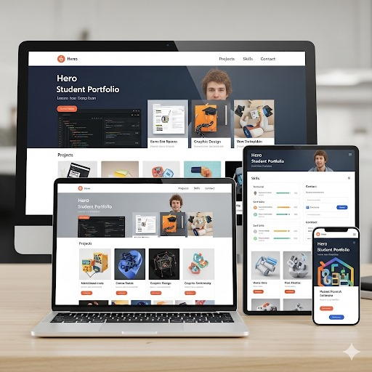
Project Overview
To address this, a responsive student portfolio website was developed using HTML, CSS, and JavaScript. The website acts as a digital resume where students can showcase their personal details, projects, skills, and contact information. It is interactive, user-friendly, and accessible on multiple devices, providing a modern way to present achievements and stand out in today’s competitive environment.

Slide 6
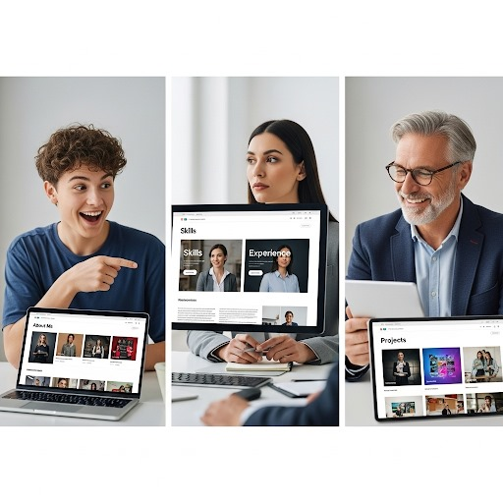
End Users
Students – The portfolio helps students present their skills and projects in an interactive and professional way, making them stand out.
Recruiters – It allows recruiters to quickly evaluate technical knowledge and practical work through real project showcases.
Teachers/Mentors – Mentors can review student progress, creativity, and strengths to provide better guidance and support.

Slide 7
Tools & Technologies
The portfolio uses:
• HTML for structure
• CSS for styling
• JavaScript for interactivity
• GitHub for version control and hosting

Slide 8
Portfolio Design & Layout
Includes:
• Navbar for quick access to sections.
• Hero Section to create a strong first impression
• About Section to highlight the student’s background and skills.
• Projects Grid showcases completed work in an organized manner
• Contact Form allows recruiters or mentors to connect directly
• Footer provides quick links and essential details, ensuring a complete and professional presentation.

Slide 9
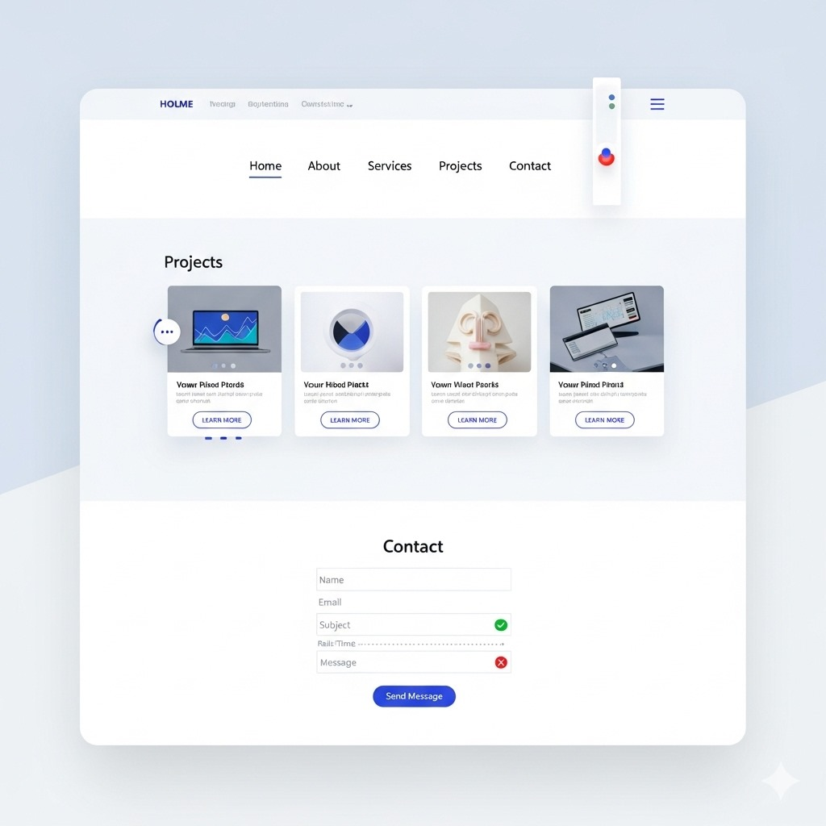
Features & Functionality
• Responsive navigation
• Interactive design
• Contact form validation
• Smooth scrolling
• Hover effects on projects

Slide 10
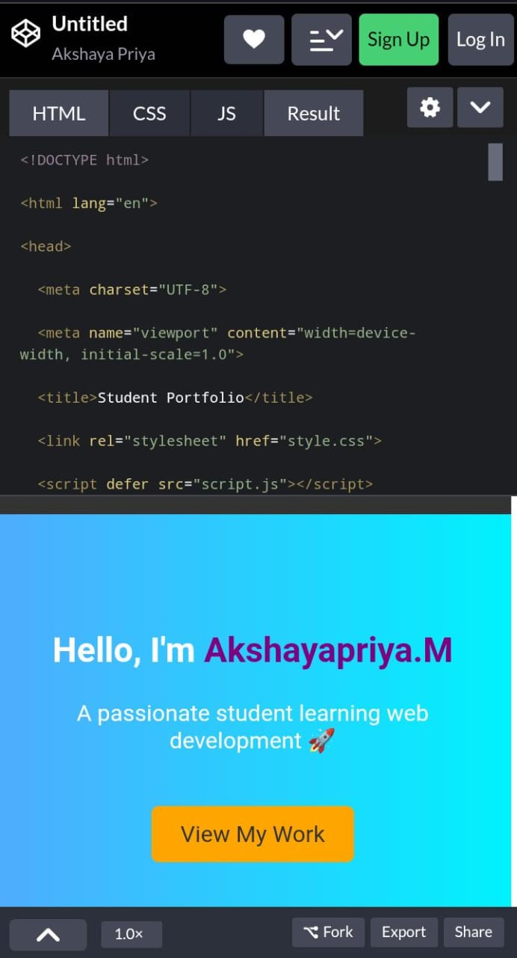
Results & Screenshots
This section shows how the portfolio looks in action. Screenshots of Hero, About, Projects, and Contact sections are included.

Slide 11
Conclusion
The portfolio provides a modern and effective way to showcase student projects, improving visibility to recruiters and mentors.

Slide 12
GitHub Link
Access the source code and live project via GitHub.
Link:
https://codepen.io/Akshaya-Priya-the-looper/pen/YPydRWB

